Slide 1

Software Quality Assurance and Test Automation
Track Overview
Software Quality Assurance
Telerik Software Academy
http://academy.telerik.com

Slide 2
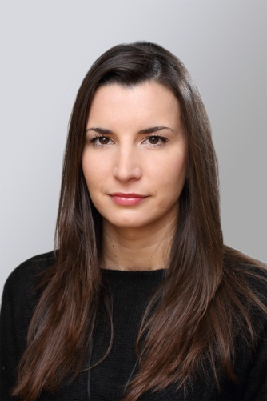
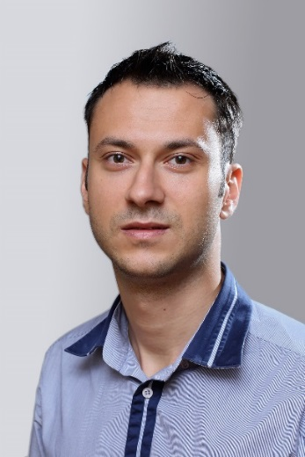
The Lectors
Snejina Lazarova
Project Manager
BI & Reporting Team
Dimo Mitev
QA Architect
Backend Services Team

Slide 3

Table of Contents
Course Objectives
Trainers Team
Course Curriculum and Exams
Course Schedule
Assessment
Recommended Resources
Notes:
Results from the course?

Slide 4

Course Objectives
Why Do We Teach This Course?

Slide 5
SQA Track Objectives
“Software Quality Assurance” track:
Give the trainees the fundamental knowledge and skills required in Quality Assurance
Establish the logical and critical thinking
Development of problems solving skills
Learn basic test design techniques
Study the most popular test automation tools

Slide 6

Trainers Team

Slide 7
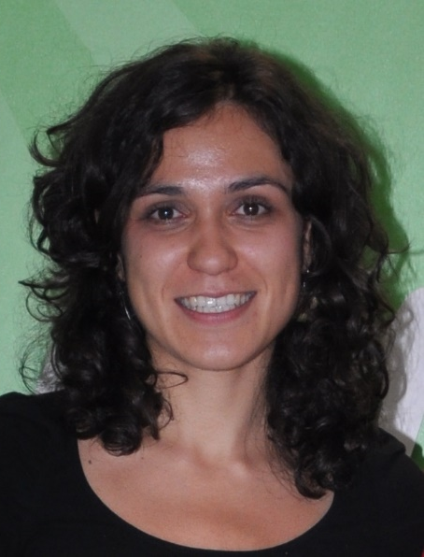
Trainers Team
Asya Georgieva
The main organizer of QA Track 2015
QA Engineer @ AppBuilder Team
Experienced in functional testing and interest in Exploratory approach
ISTQB foundation level certified
E-mail: asya.georgieva[at]telerik.com

Slide 8
Trainers Team
Snejina Lazarova
Product Manager @ BI & Reporting Team
Over 9 years experience in QA
Experienced in automation, functional, performance and web service testing
ISTQB foundation and advanced level certified
E-mail: snejina.lazarova[at]telerik.com

Slide 9

Trainers Team
Dimo Mitev
QA Architect @ Backend Services Team
10 years QA experience in 4 companies
Experienced in automation, functional and web service testing
ISTQB foundation and advanced level certified
1 publication in Quality Matters magazine
E-mail: dimo.mitev[at]telerik.com

Slide 10
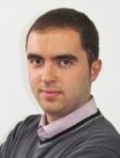
Trainers Team
Angel Tsvetkov
QA Architect @ Core Services Team
7 years QA experience
Experienced in automotive software testing, web, stand alone and mobile apps testing
E-mail: angel.tsvetkov[at]telerik.com

Slide 11
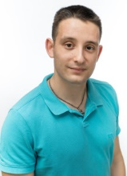
Trainers Team
Anton Angelov
QA Architect @ Licensing Team
Experienced performance, automation, web service and data base testing
ISTQB foundation and advanced level certified
E-mail: anton.angelov[at]telerik.com

Slide 12
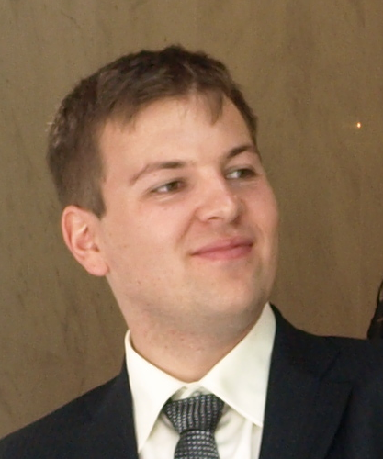
Trainers Team
Dimitar Topuzov
Principal QA Engineer @ NativeScript Modules Team
Over 9 years experience in QA
Experience in various domains, including
Dev Tools (Telerik WPF and Silverlight Controls)
Test Automation Tools (Borland’s Silk products)
Data warehouse and BI solutions
E-mail: dimitar.topuzov[at]telerik.com

Slide 13

Trainers Team
Iliyan Panchev
Product Manager@ Mobile Testing & Test Studio Product ManagementTeam
Experienced in automation, functional and mobile apps testing
E-mail: iliyan.panchev[at]telerik.com

Slide 14
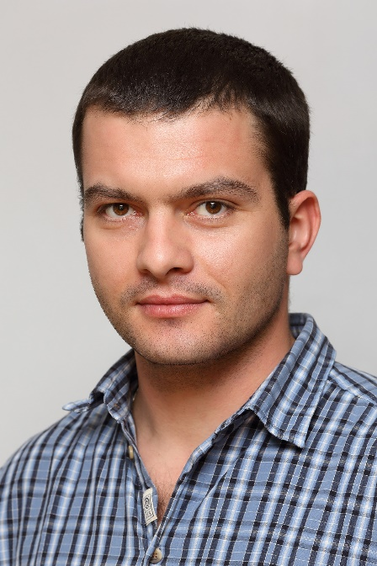
Trainers Team
Mihail Parvanov
Manager, QA @ ASP .NET AJAX Team
7+ years QA experience
Experienced in automation, functional and performance testing
ISTQB foundation level certified
E-mail: mihail.parvanov[at]telerik.com

Slide 15

Trainers Team
Neven Dinev
QA Architect @ AppBuilder Team
Quality manager with experienced in automation, functional and performance testing
E-mail: neven.dinev[at]telerik.com

Slide 16
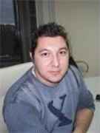
Trainers Team
Nikolay Nedyalkov
QA Architect @ XAML Division
Experienced in Silverlight and WPF automation testing
E-mail: nikolay.nedyalkov[at]telerik.com

Slide 17
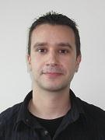
Trainers Team
Petar Horozov
Principal QA Engineer @ XAML Team2
8+ years experience in software testing and QA
Experienced in Silverlight and WPF automation testing
E-mail: petar.horozov[at]telerik.com

Slide 18
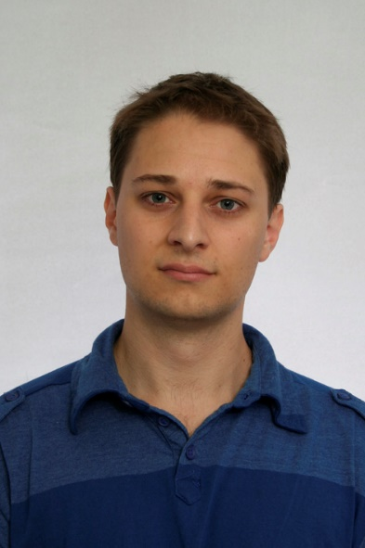
Trainers Team
Georgi Darakchiev
Principal QA Engineer @ XAML Team3
First Telerik QA Academy graduate
Experienced in Silverlight and WPF automation testing
E-mail: georgi.darakchiev[at]telerik.com

Slide 19
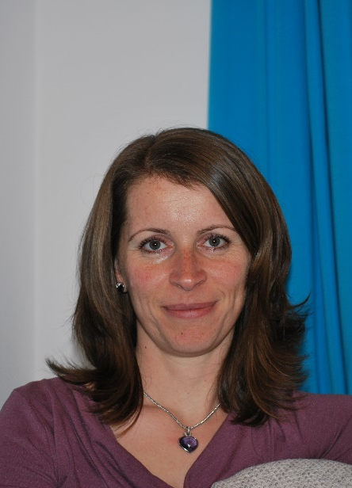
Trainers Team
Miroslava Ivanova
Senior QA Engineer @ iOS Team
10 years experience in software testing
Experienced in Desktop and Mobile manual and automation testing
E-mail: miroslava.ivanova[at]telerik.com

Slide 20

Track Curriculum and Exams

Slide 21

Curriculum
Fundamentals of Testing
Fundamental Test Process
Test Levels and Types
Software Development Models
Risk and Testing
Test Organization
Test Planning and Estimation

Slide 22

Curriculum
Test Progress Monitoring and Control
Tools for Management of Testing and Tests
Test Automation Basics
Web Testing
Automated Testing with Selenium
Automated Testing with Selenium WebDriver
Automated Testing with Telerik Test Studio
Intermediate Exam – 7.12

Slide 23
Curriculum
Automated Testing with Telerik Testing Framework
Build Test Automation Framework
Test Design Techniques
Deriving test cases based on
Equivalence Partitioning
Boundary Value Analysis
Use Case Testing
Decision Table Testing

Slide 24

Curriculum
Deriving test cases based on
State Transition Testing
Pairwise Testing
Classification Trees
Defect Taxonomies, Error Guessing, Checklist Testing and Exploratory Testing
Static Techniques
Automated Testing with Sikuli
Intermediate Exam – 18.01

Slide 25

Curriculum
Mobile Testing
Performance Testing
Web Service Testing
Security Vulnerability Testing
Set up QA process
Intermediate Exam – 8.02

Slide 26
Curriculum
Additional Topics
BDD with SpecFlow
WebService Testing
Build Test Automation Framework part II
Python
Workshops
Incident Management
Learn the Command Line
Mobile testing

Slide 27

Course Schedule

Slide 28

Training Duration
Lectures: ~ 90 hours
Practical exercises: ~ 60 hours
Exams: ~ 20 hours
Homework and Teamwork: ~ 200 hours

Slide 29

Schedule
Time allocation
3 months * 3 days weekly, 4 hours / day
Mondays and Wednesdays from 4 to 8 PM
lectures + work in class with the trainer
Fridays from 3 to 7 PM
work in class
practical exercises, advanced topics, workshops and teamwork

Slide 30

Assessment
Quality
Assurance
How, What, When?

Slide 31
The Exams
Assessment for the course is based on multiple intermediate exams
There is no comprehensive final exam
Each intermediate exam covers the preceding topics
The final score is cumulative
Exams measure individual performance
Serve as filter for skillful people
Exams are not the only filter!

Slide 32

Homework
Most topics include homework assignments
Homeworks are obligatory
Students who do not fulfill their homeworks fall off the program
Homework assignments are due to in a week after each lecture
Submission will be accepted through the student's system: telerikacademy.com

Slide 33
Homework Peer Reviews
Everyone will get feedback for their homework
Everyone will give feedback for few random homework submissions
Students submit homework anonymously
Please exclude your name from the submissions!
For each homework submitted
Students evaluate 3 random homeworks
From the same topic, after the deadline
Give written feedback, at least 200 characters
Low-quality feedback → report for punishment

Slide 34
Evaluation for onsite participants
Formal Criteria
Criterion | Weight
Exams (*3) | 55%
Team works | 30%
Homework | 10%
Homework evaluation | 5%
Informal Criteria
Forum activity – bonus up to 5%
Attendance – send e-mail notifications
Participation – ask questions, give ideas, express your thoughts

Slide 35

Recommended Resources

Slide 36
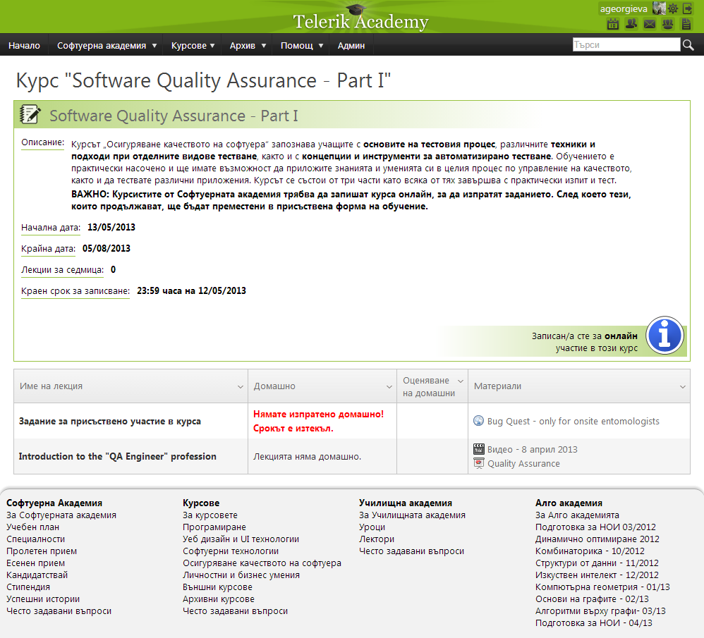
Telerik Integrated Learning System (TILS)
The Telerik Integrated Learning System (TILS)
www.telerikacademy.com
Important resource for all students
Homework submissions
Homework peer reviews
Presence cards with barcode
Reports about your results
http://telerikacademy.com/Courses/Courses/Details/290

Slide 37
Course Web Site & Forums
The SQA Track official web site:
Register for the "Telerik Academy Forums":
Discuss the course exercises with your colleagues
Share ideas
http://academy.telerik.com/student-courses/software-technologies/software-quality-assurance/about
http://telerikacademy.com/Forum/Category/13/qa-academy

Slide 38

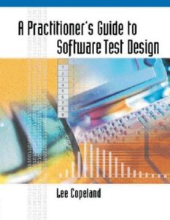
Recommended Books
Lessons Learned in Software Testing: A Context-Driven Approach By Bret Pettichord, James Bach, Cem Kaner
A Practitioner's Guide to Software Test Design
By Lee Copeland

Slide 39
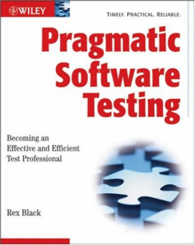
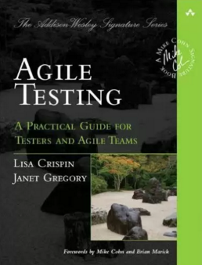
Recommended Books (2)
Pragmatic Software Testing: Becoming an Effective and Efficient Test Professional, By Rex Black
Agile Testing: A Practical Guide for Testers and Agile Teams
By Lisa Crispin, Janet Gregory

Slide 40
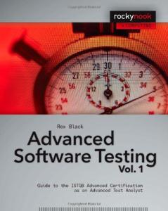

Recommended Books (3)
Advanced Software Testing Vol. 1: Guide to the ISTQB Advanced Certification as an Advanced Test Analyst By Rex Black
Advanced Software Testing Vol. 2: Guide to the ISTQB Advanced Certification as an Advanced Test Manager By Rex Black

Slide 41
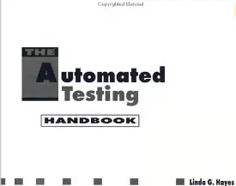

Recommended Books (4)
Automated Testing Handbook
By Linda G. Hayes
Head First Design Patterns
By Eric Freeman, Elisabeth Robson, Bert Bates, Kathy Sierra

Slide 42


Recommended Books (5)
Selenium 2 Testing Tools: Beginner's Guide By Burns David
Training Kit (Exam 70-461) Querying Microsoft SQL Server 2012 (MCSA)
By Dejan Sarka, Itzik Ben-Gan, Ron Talmage

Slide 43
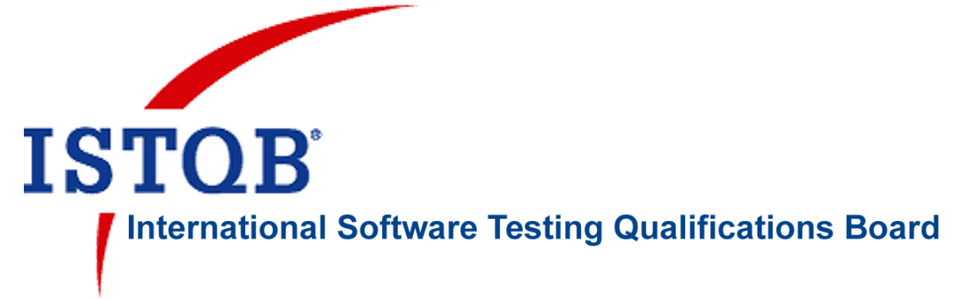
Web Resources
ISTQB (International Software Testing Qualifications Board) syllabus
http://istqb.org/

Slide 44
Software Quality Assurance
?
?
?
?
?
Questions?
?
?
?
?
?
?

Slide 45
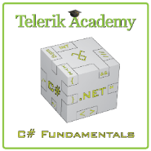



Free Trainings @ Telerik Academy
C# Programming @ Telerik Academy
csharpfundamentals.telerik.com
Telerik Software Academy
academy.telerik.com
Telerik Academy @ Facebook
facebook.com/TelerikAcademy
Telerik Software Academy Forums
forums.academy.telerik.com

